Slide 1
Algorithms and Data Structures TEB1113/TFB2023 - may 2025
lecturer: DR. Shashi Bhushan
LAB TA: Reeyan afzal

Slide 2

LAB – 8 trees - ii

Slide 3
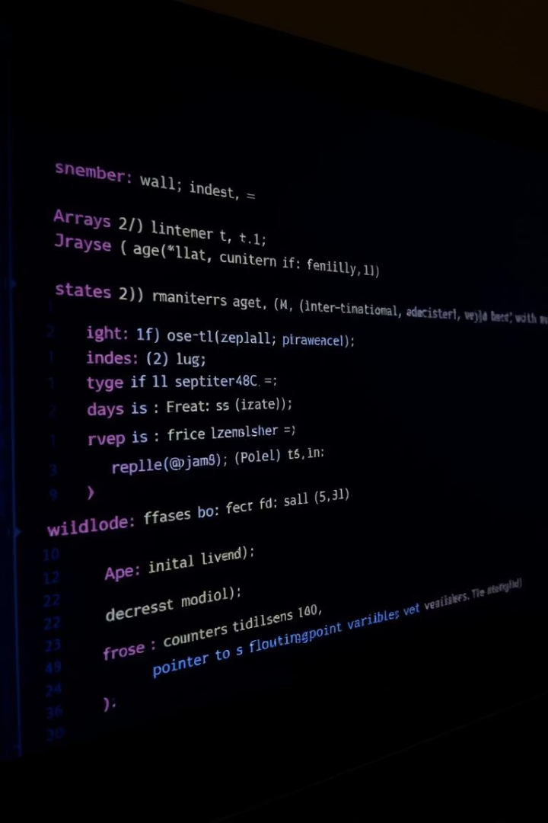
Objectives for lab-8
The students will learn about BST, heap, and B-tree data structures.
The students will be able to implement and apply these data structures to solve various computational problems.
To understand the concept of binary search tree (BST), heap, and height-balancing trees like AVL and B-tree, and develop the ability to use those data structures to solve real-world problems.

Slide 4

binary search tree
A Binary search tree is a binary tree with some restrictions.
In the binary search tree, the value of the root node will be larger than any node in the left subtree and will be smaller than any node in the right subtree.
Because of this restriction searching time of an element will be reduced to 𝑂(𝑙𝑜𝑔𝑁).

Slide 5
Almost complete binary tree
An almost complete binary tree is a binary tree with some restriction in which all the levels are filled except possibly the last level, and the last level has all keys as far left as possible.

Slide 6
heap
Heap: A Heap is a special Tree-based data structure in which the tree is a complete binary tree. Heaps are of two types, i.e., Max-Heap and Min-Heap.
Max-Heap: In a Max-Heap, the key present at the root node must be maximum among the keys present at all of its children. The same property must be recursively true for all sub-trees in that Binary Tree.
Min-Heap: In a Min-Heap, the key present at the root node must be minimum among the keys present at all of its children. The same property must be recursively true for all sub-trees in that Binary Tree.

Slide 7
Height balancing tree
Height-balancing tree means the difference of the height of the left subtree and the height of the right subtree of any node is not more than 1.
While inserting elements in a height-balancing tree for any node, if the height difference of the left and right subtrees exceeds 1, then appropriate action will immediately be taken to balance the height.
The advantage of height-balancing trees is that, in the worst case, also searching for an element will take 𝑂(𝑙𝑜𝑔𝑁) time. AVL tree and B-Tree an examples of height-balancing trees.

Slide 8
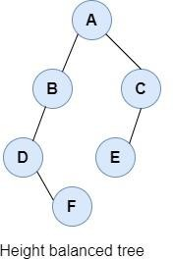
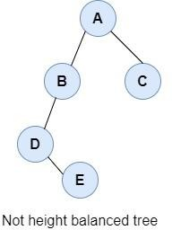
Height balancing tree

Slide 9
Lab-task
Creation of Max-Heap and Min-Heap.
Insertion and deletion of elements in a heap.
Problems on a binary search tree.
Problems with B-Tree creation.
Problems with adding elements in a B-Tree.
Problems in removing elements from a B-Tree.

